Slide 1
3 Careers
A presentation brought to you by Johnny Rey

Slide 2
What my interested careers are
The 3 careers I chose to give information on was enlisted military recruit, police officer, and FBI agent. My main ambition is to be part of law enforcement and armed forces to serve and protect and enforce justice to the “unjust.” Enlisting into the military is my first career option, serving an unknown amount of years and enlisting to either the Marines or Navy; while in the military, I’ll pursue a college education. I would like to serve in the military then leave and pursue a career in law enforcement. My main career would to be part of the Federal level of law enforcement (FBI, CIA, DEA).

Slide 3
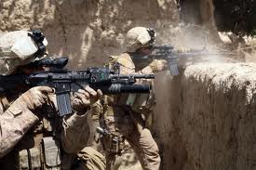
Military Service (what they do)
Participate in, or support, combat and other military operations, such as humanitarian or disaster relief
Operate, maintain, and repair equipment
Perform technical and support activities
Supervise junior enlisted personnel
The work schedule varies, in many circumstances, military personnel work standard full time. However, hours vary significantly, depending on occupational specialty, rank, branch of service, and the needs of the military. In all cases, personnel must be prepared to work long hours to fulfill missions. (U.S. Bureau of Labor Statistics.)

Slide 4
Qualifications
Military members must be physically fit, mentally stable, and ready to participate in or support combat missions that may be difficult and dangerous and involve long periods of time away from family; however, some personnel are rarely deployed near combat areas.
For the Marines, every Marine is a rifleman; so, no matter what job they have, anyone can be sent to front line battles or missions. Marines must maintain fitness and be ready for combat.
For the Navy, sailors can be sent out to seas for months, so a qualification could be to handle living on a ship for months. Also maintaining fitness, unlike the Marines though, the Navymen see little or no combat, except Navy SEALs.

Slide 5
Other Qualifications
Mental preparedness. Members of the Armed Forces must be mentally stable and able to handle stressful situations that can occur during military operations.
Physical fitness. Military members must be physically fit to participate in or support combat missions that may be difficult or dangerous.
Readiness. Members of the Armed Forces must be ready and able to report for military assignments on short notice.
To enter the service, applicants must:
Minimum of 17 years of age
U.S. citizenship or permanent resident status
Pass a background investigation
Never convicted of a felony
Able to pass a drug test (U.S. Bureau of Labor Statistics.)

Slide 6
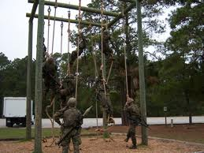
Everyone starts at Boot Camp…
Newly enlisted members of the Armed Forces go through basic training or boot camp. Basic training includes courses in military skills and protocols and typically lasts 8 to 13 weeks, including a week of orientation and introduction to military life.
Basic training also includes weapons training, team building, and rigorous physical exercise designed to improve strength and endurance.
Following basic training, military members attend additional training at technical schools that prepare them for a particular military occupational specialty. This formal training period generally lasts from 10 to 20 weeks. Training for certain occupations—nuclear power plant operator, for example—may take as long as a year. In addition to getting classroom instructions, military members receive on-the-job training at their first duty assignment. (U.S. Bureau of Labor Statistics.)

Slide 7
The Pay… (U.S. Bureau of Labor Statistics.)
Pay Grade | 2 or less | Over 2 | Over 3 | Over 4 | Over 6 | Over 8 | Over 10 | Over 12 | Over 14 | Over 16 | Over 20
O-10 |  |  |  |  |  |  |  |  |  |  | $15,913.20
O-9 |  |  |  |  |  |  |  |  |  |  | 13,917.60
O-8 | $9,847.80 | $10,170.30 | $10,384.50 | $10,444.20 | $10,711.50 | $11,157.60 | $11,261.40 | $11,685.00 | $11,806.50 | $12,171.60 | 13,187.10
O-7 | 8,182.50 | 8,562.90 | 8,738.70 | 8,878.50 | 9,131.70 | 9,381.90 | 9,671.10 | 9,959.40 | 10,248.60 | 11,157.60 | 11,924.70
O-6 | 6,064.80 | 6,663.00 | 7,100.10 | 7,100.10 | 7,127.10 | 7,432.80 | 7,473.00 | 7,473.00 | 7,897.80 | 8,648.70 | 9,529.80
O-5 | 5,055.90 | 5,695.50 | 6,089.70 | 6,164.10 | 6,410.10 | 6,557.10 | 6,880.80 | 7,118.40 | 7,425.30 | 7,895.10 | 8,338.80
O-4 | 4,362.30 | 5,049.90 | 5,386.80 | 5,461.80 | 5,774.70 | 6,109.80 | 6,527.70 | 6,852.90 | 7,078.80 | 7,208.70 | 7,283.70
O-3 | 3,835.50 | 4,347.90 | 4,692.90 | 5,116.50 | 5,361.60 | 5,630.70 | 5,804.70 | 6,090.60 | 6,240.00 | 6,240.00 | 6,240.00
O-2 | 3,314.10 | 3,774.30 | 4,347.00 | 4,493.70 | 4,586.40 | 4,586.40 | 4,586.40 | 4,586.40 | 4,586.40 | 4,586.40 | 4,586.40
O-1 | 2,876.40 | 2,994.00 | 3,619.20 | 3,619.20 | 3,619.20 | 3,619.20 | 3,619.20 | 3,619.20 | 3,619.20 | 3,619.20 | 3,619.20
W-5 |  |  |  |  |  |  |  |  |  |  | 7,047.90
W-4 | 3,963.90 | 4,263.90 | 4,386.00 | 4,506.60 | 4,713.90 | 4,919.10 | 5,126.70 | 5,439.60 | 5,713.50 | 5,974.20 | 6,395.40
W-3 | 3,619.50 | 3,770.40 | 3,925.20 | 3,975.90 | 4,138.20 | 4,457.10 | 4,789.20 | 4,945.50 | 5,126.40 | 5,313.00 | 5,874.30
W-2 | 3,202.80 | 3,505.80 | 3,599.40 | 3,663.30 | 3,871.20 | 4,194.00 | 4,353.90 | 4,511.40 | 4,704.00 | 4,854.30 | 5,153.70
W-1 | 2,811.60 | 3,114.00 | 3,195.30 | 3,367.50 | 3,570.90 | 3,870.60 | 4,010.40 | 4,205.70 | 4,398.30 | 4,549.80 | 4,858.20
E-9 |  |  |  |  |  |  | 4,788.90 | 4,897.50 | 5,034.30 | 5,194.80 | 5,617.50
E-8 |  |  |  |  |  | 3,920.10 | 4,093.50 | 4,200.90 | 4,329.60 | 4,469.10 | 4,847.70
E-7 | 2,725.20 | 2,974.50 | 3,088.20 | 3,239.10 | 3,357.00 | 3,559.20 | 3,673.20 | 3,875.70 | 4,043.70 | 4,158.60 | 4,328.40
E-6 | 2,357.10 | 2,593.80 | 2,708.10 | 2,819.40 | 2,935.50 | 3,196.50 | 3,298.50 | 3,495.30 | 3,555.60 | 3,599.70 | 3,650.70
E-5 | 2,159.40 | 2,304.30 | 2,415.90 | 2,529.90 | 2,707.50 | 2,893.50 | 3,045.60 | 3,064.20 | 3,064.20 | 3,064.20 | 3,064.20
E-4 | 1,979.70 | 2,081.10 | 2,193.90 | 2,304.90 | 2,403.30 | 2,403.30 | 2,403.30 | 2,403.30 | 2,403.30 | 2,403.30 | 2,403.30
E-3 | 1,787.40 | 1,899.90 | 2,014.80 | 2,014.80 | 2,014.80 | 2,014.80 | 2,014.80 | 2,014.80 | 2,014.80 | 2,014.80 | 2,014.80
E-2 | 1,699.80 | 1,699.80 | 1,699.80 | 1,699.80 | 1,699.80 | 1,699.80 | 1,699.80 | 1,699.80 | 1,699.80 | 1,699.80 | 1,699.80
E-1 | 1,516.20

Slide 8
Job Outlook
Opportunities should be good for qualified individuals in all branches of the Armed Forces through 2022. All services have needs to fill entry-level and professional positions as members of the Armed Forces move up through the ranks, leave the service, or retire.
When the economy is thriving and civilian employment opportunities generally are more favorable, it is more difficult for the military to meet its recruitment quotas. It is also more difficult to meet these goals during times of war, when recruitment goals typically rise. During economic downturns, candidates for military service may face competition. (U.S. Bureau of Labor Statistics.)

Slide 9
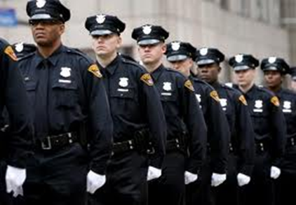
Police Officer (what they do)
Enforce laws
Respond to emergency and non-emergency calls
Patrol assigned areas
Conduct traffic stops and issue citations
Obtain warrants and arrest suspects
Write detailed reports and fill out forms (maybe I do need English Class, just not AP Lit)
Prepare cases and testify in court
Police officers pursue and apprehend people who break the law. They then warn, cite, or arrest them. Most police officers patrol their jurisdictions and investigate suspicious activity. They also respond to calls, issue traffic tickets, and give first aid to accident victims.
(U.S. Bureau of Labor Statistics.)

Slide 10
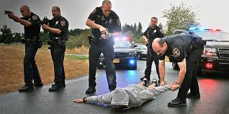
Qualifications
Education requirements range from a high school diploma to a college, or higher, degree.
Most police and detectives must graduate from their agency’s training academy before completing a period of on-the-job training.
Candidates must be U.S. citizens, usually at least 21 years old, and meet rigorous physical and personal qualifications.
Candidates typically go through a series of interviews and may be asked to take lie detector and drug tests.
A felony conviction may disqualify a candidate. (U.S. Bureau of Labor Statistics.)

Slide 11
Other Qualifications
Communication skills. Police and detectives must be able to speak with people when gathering facts about a crime and to express details about a given incident in writing.
Empathy. Police officers need to understand the perspectives of a wide variety of people in their jurisdiction and have a willingness to help the public.
Good judgment. Police and detectives must be able to determine the best way to solve a wide array of problems quickly.
Leadership skills. Police officers must be comfortable with being a highly visible member of their community, as the public looks to them for assistance in emergency situations.
Perceptiveness. Officers must be able to anticipate another person’s reactions and understand why people act a certain way.
Physical stamina. Officers and detectives must be in good physical shape, both to pass required tests for entry into the field, and to keep up with the daily rigors of the job.
Physical strength. Police officers must be strong enough to physically apprehend offenders. (U.S. Bureau of Labor Statistics.)

Slide 12
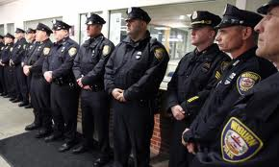
Pay
The median annual wage for police and detectives was $56,980 in May 2012.
The median wage is the wage at which half the workers in an occupation earned more than that amount and half earned less.
The lowest 10 percent earned less than $33,060, and the top 10 percent earned more than $93,450.
Uniformed officers, detectives, agents, and inspectors usually are scheduled to work full time. Paid overtime is common. Shift work is necessary, because protection must be provided around the clock. Because more experienced employees typically receive preference, junior officers frequently work weekends, holidays, and nights. (U.S. Bureau of Labor Statistics.)

Slide 13
Union
Compared with workers in all occupations, police and detectives had a higher percentage of workers who belonged to a union in 2012. (U.S. Bureau of Labor Statistics.)

Slide 14
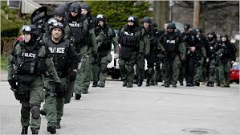
Job Outlook
Employment of police and detectives is projected to grow 5 percent from 2012 to 2022, slower than the average for all occupations.
Continued desire for public safety will result in a need for more officers. However, demand for employment is expected to vary depending on location, driven largely by local and state budgets. Even with crime rates falling in the last few years, there will be continued demand for police services to maintain and improve public safety.
Applicants with a bachelor's degree and law enforcement or military experience, especially investigative experience, as well as those who speak more than one language, should have the best job opportunities. (U.S. Bureau of Labor Statistics.)

Slide 15
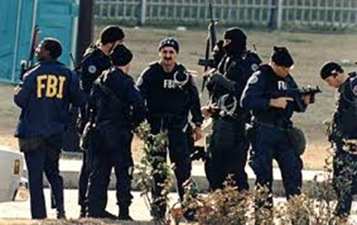
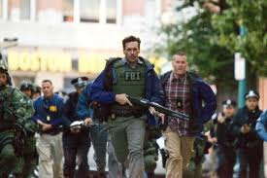
Federal Agent (what they do)
FBI Special Agents are responsible for conducting sensitive national security investigations and for enforcing over 300 federal statutes.
FBI Special Agents work on matters including terrorism, foreign counterintelligence, cyber crime, organized crime, white-collar crime, public corruption, civil rights violations, financial crime, bribery, bank robbery, extortion, kidnapping, air piracy, interstate criminal activity, fugitive and drug-trafficking matters, and other violations of federal statutes. (Federal Bureau of Investigation- Careers)

Slide 16
Qualifications
Must be a US citizen
Must be at least 23 years of age to apply and have not reached 37 years of age upon your appointment as a Special Agent
Must possess a four-year degree from a college or university accredited by one of the regional or national institutional associations recognized by the United States Secretary of Education.
Must have at least three years of professional work experience.
Must also possess a valid driver's license and be completely available for assignment anywhere in the FBI's jurisdiction.
Must be physically fit
Must undergo an extensive background investigation (Federal Bureau of Investigation- Careers)

Slide 17
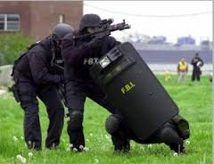
Special Agent Entry Programs
All applicants for the Special Agent position must first qualify under one of five Special Agent Entry Programs. These programs include:
Accounting
Computer Science/Information Technology
Language
Law
Diversified (Federal Bureau of Investigation- Careers)

Slide 18
“Special Skills”
After qualifying for one of the five Entry Programs, applicants will be prioritized in the hiring process based upon certain Critical Skills for which the FBI is recruiting. The FBI is currently recruiting for Special Agent candidates with one or more of the following Critical Skills:
Accounting
Finance
Computer Science/Information Technology Expertise
Engineering Expertise
Foreign Language(s) Proficiency
Intelligence Experience
Law Experience
Law Enforcement/Investigative Experience
Military Experience
Physical Sciences (e.g., physics, chemistry, biology, etc.) Expertise
Diversified Experience

Slide 19
Pay
Special Agent trainees at the FBI Academy are paid as GS-10, step 1 ($43,441) plus the Quantico, VA locality adjustment (17.50%) during their time at the FBI Academy. This equates to $51,043 on an annualized basis (or $1,963 per each two-week pay period).
Newly assigned Special Agents are paid as GS-10, step 1 ($43,441) plus locality pay and availability pay. Locality pay (which ranges from 12.5% to 28.7% of base salary depending upon office assignment) is additional compensation to account for differences in the labor market between different areas. Availability pay is a 25% increase in adjusted salary (base salary + locality pay) for all Special Agents due to their requirement to average a 50-hour work week over the course of the year. Thus, with the locality and availability pay adjustments, new Special Agents in their first Field Offices earn between $61,100 and $69,900, depending upon the region of the country to which they are assigned. (Federal Bureau of Investigation- Careers)

Slide 20
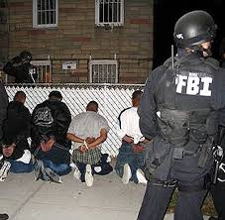
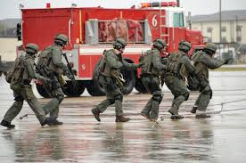
Job Outlook
Similar to police officers, Federal Agents are always in demand; but competition is always increasing and only certain people can become a Special Agent. They must have a clean background record, physical and mental toughness, great eyesight, education and training. In other words, agents must have above average amount of “human capital.”
Applicants with a bachelor's degree and law enforcement or military experience, especially investigative experience, as well as those who speak more than one language, should have the best job opportunities. (Federal Bureau of Investigation- Careers)

Slide 21
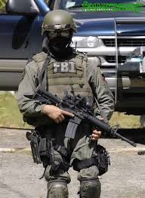
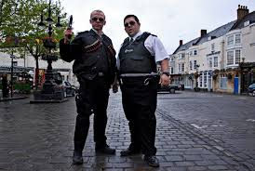
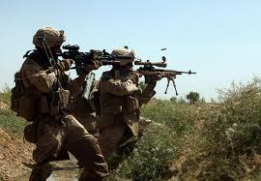
In Conclusion…
The chances of myself getting into these careers are quite evitable; however, they are indeed very life threatening and my life could be on the line. I could die, and if I do, I would rather die for something , like my family, than to die for nothing.

Slide 22
Works Cited
"What They Do About This Section." U.S. Bureau of Labor Statistics. U.S. Bureau of Labor Statistics, n.d. Web. 11 Jan. 2014. <http://bls.gov/ooh/military/military-careers.htm>.
"Summary." U.S. Bureau of Labor Statistics. U.S. Bureau of Labor Statistics, n.d. Web. 11 Jan. 2014. <http://bls.gov/ooh/protective-service/police-and-detectives.htm>.

