Slide 1
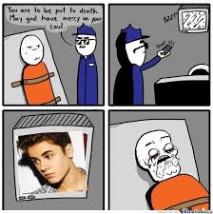
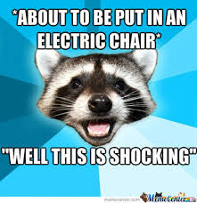
The death penalty
A presentation brought to you by Johnny Rey Salazar

Slide 2
What is the Death Penalty?
The death penalty, or capital punishment, has been in use for centuries; the death penalty is a legal process where a person is put to death by the state as a punishment for a crime.

Slide 3
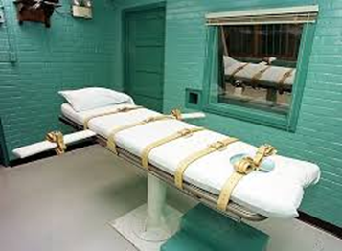
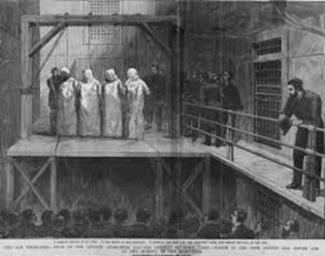
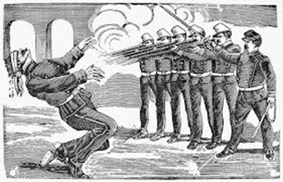
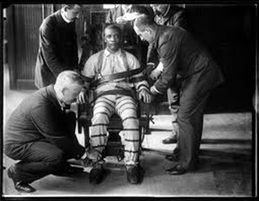
What are methods to carry out the death penalty?
Lethal injection is the sole method in 35 states, including California and Nevada.
Electrocution (used in 8 states including Alabama)
Gas chamber (used in 3 states such as Arizona)
Hanging (used in 3 states including Delaware)
Firing Squad (used in 1 state, Oklahoma, but only if lethal injection and electrocution are found unconstitutional) (Prison Facts)

Slide 4
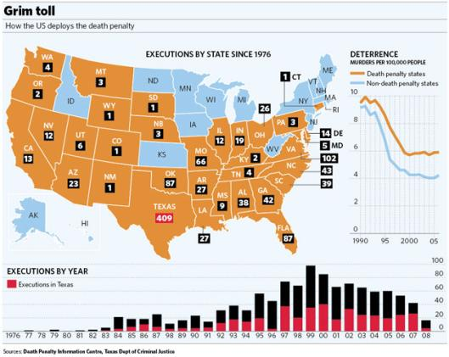
Death Penalty Statistics (Google Images)

Slide 5
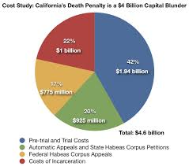
The COSTS of the death penalty (in California)
According to state and federal records obtained by The Los Angeles Times, maintaining the California death penalty system costs taxpayers more than $114 million a year beyond the cost of simply keeping the convicts locked up for life.
This figure does not count the millions more spent on court costs to prosecute capital cases.
This additional cost per prisoner adds up to $57.5 million in annual spending. (Costs of the Death Penalty)

Slide 6
California Death Penalty (image)

Slide 7
Comparison of living in prison and being on death row
LIVING IN PRISON
Prisons cost taxpayers more than $32 billion a year. Every year that an inmate spends in prison costs $22,000.
An individual sentenced to five years for a $300 theft costs the public more than $100,000. The cost of a life term averages $1.5 million.
DEATH ROW
$1.94 billion--Pre-Trial and Trial Costs
$925 million--Automatic Appeals and State Habeas Corpus Petitions
$775 million--Federal Habeas Corpus Appeals
$1 billion--Costs of Incarceration
(Costs of the Death Penalty)

Slide 8
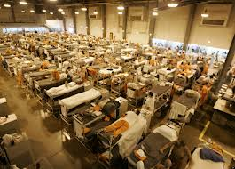
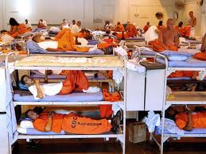
What costs more?
Living in prison costs less than to be put on death row; however, overcrowding has impacted prisons, spending millions of dollars on convicts.
As of 2005, there are 2 million people locked up in federal, state, and county facilities. Though crime rates are down, that's up more than 600% since the 1970s. More than 6 million people are under state supervision in the form of parole or probation. The United States incarcerates more people than any other country in the world. (Prison Facts)

Slide 9
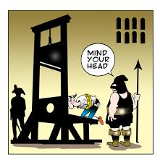
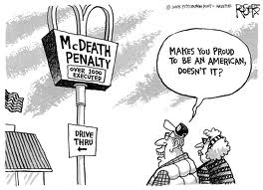
Why is the death penalty expensive?
The death penalty is much more expensive than life without parole because the Constitution requires a long and complex judicial process for capital cases. This process is needed in order to ensure that innocent men and woman are not executed for crimes they did not commit, and even with these protections the risk of executing an innocent person can not be completely eliminated. (Top 10 Pros and Cons - Death Penalty)

Slide 10
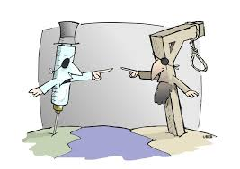
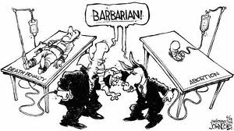
Which is more economically “better”
The death penalty is significantly more expensive than condemning a person to die in prison because the death penalty takes years to take into function and the money spent on the materials, trials, and treatment of the convict is substantial. Housing prisoners on death row costs California tax payers an additional $90,000 per prisoner per year, above what it would cost to house them in prison, which adds up to $59 million a year. The price tag for California’s new death row is $336 million. All of those costs would be avoided if the people on death row were sentenced to die in prison and moved to the general population. (Top 10 Pros and Cons - Death Penalty)

Slide 11
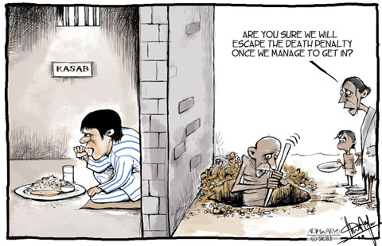
How could the money used on the death penalty be used differently?
A millions of tax payer’s money is used to house inmates on death row, for years. The money used on the death penalty could be used differently, for example, in education; or, the controversial medical insurance, Obamacare. In Colorado, $10,000 is spent per student, whereas, $30,000 is spent on per inmates. The money spent on inmates, to house criminals and make sure they are healthy and alive is disturbing, where innocent people who can’t afford health insurance have to suffer. In prison, inmates have full health insurance, meals everyday, and a bed to sleep in; more than that of a person dealing with poverty. (Top 10 Pros and Cons- Death Penalty)

Slide 12
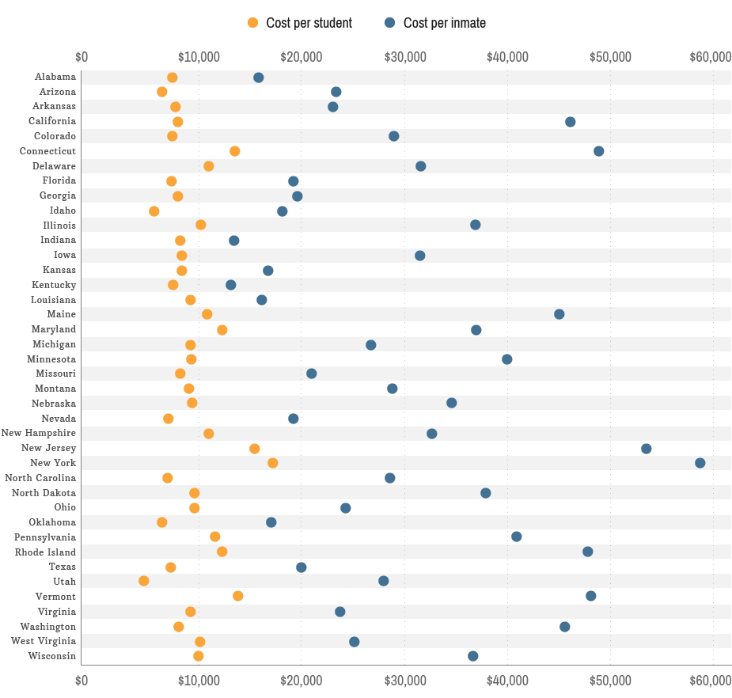
Money Spent on Education VS Prison (CNN Money)

Slide 13
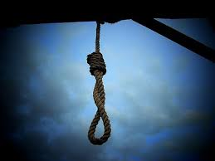
What could be “re-vamped” to better the death penalty?
The death penalty is expensive, and finding a way to execute convicts without being unconstitutional is extremely difficult. Many methods, such as firing squad and gas chamber, have already been found unconstitutional. A way to execute those sentence to death would be hanging; hanging is quick, near to painless death, not cruel if the convict is executed in a secluded room. Rope and something to tie them to would be the only material used in carrying out this execution.

Slide 14
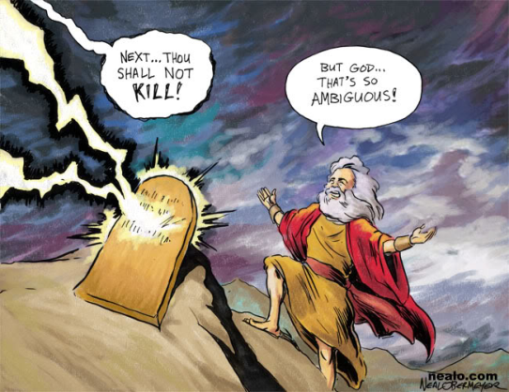
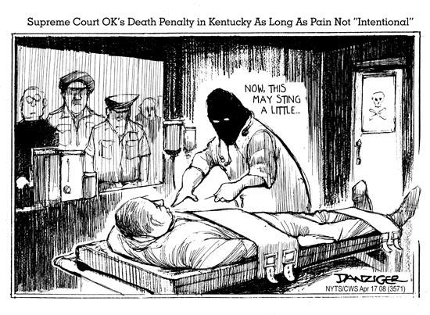
To Conclude…
Capital punishment has been around for centuries; many different methods were used to carry out the executions. Today, 32 states in the US use lethal injection as their sole method in the death penalty. Its costs are crucial financially and morally; it costs millions to carry out the execution and it could be morally wrong if carried out on an innocent person. Killing people who kill people because killing people is wrong, sounds logical; but the victim’s families feel better if the convict that hurt their family is given “justice.”

Slide 15
Works Cited
"Prison Facts." Prison Facts. N.p., n.d. Web. 10 Jan. 2014. <http://www.heartsandminds.org/prisons/facts.htm>.
"Top 10 Pros and Cons - Death Penalty - ProCon.org." ProConorg Headlines. N.p., n.d. Web. 11 Jan. 2014. <http://deathpenalty.procon.org/view.resource.php?resourceID=002000>.
"Costs of the Death Penalty." Death Penalty Information Center. N.p., n.d. Web. 09 Jan. 2014. <http://www.deathpenaltyinfo.org/costs-death-penalty>.
"Education vs Prison Costs." CNNMoney. Cable News Network, n.d. Web. 15 Jan. 2014. <http://www.money.cnn.com/infographic/economy/education-vs-prison-costs/>.

